Slide 1



email spam DETECTION
23cse203-data structures and algorithms
TEAM MEMBERS:
Devarsetty Kuldeep-CB.SC.U4CSE24712
Pasumarthy AbhinavCB.SC.U4CSE24738
Rudraraju Ethish-CB.SC.U4CSE24761
Namburi Vivek-CB.SCU4CSE24762
01

Slide 2

EMAIL SPAM DETECTION
INTRODUCTION
In the modern digital era, email is a primary mode of communication — but it is also a major target for spam and phishing attacks.
Efficient spam detection is essential to ensure user safety, save storage, and improve email reliability.
Traditional spam filtering techniques can be slow or memory-intensive when handling large datasets.
To address this, our project uses Bloom Filters for fast probabilistic spam keyword detection and Red-Black Trees for efficient and balanced data storage.
This hybrid approach combines the speed and space efficiency of Bloom Filters with the ordered data management of Red-Black Trees to create a scalable and optimized spam detection system.
02

Slide 3
EMAIL SPAM DETECTION
REAL WORLD APPLICATION
1. Email Service Providers:
Used by Gmail, Yahoo, and Outlook to quickly filter spam or phishing emails before reaching the inbox.
2. Corporate Mail Servers:
Helps organizations automatically block spam or malicious mails, improving productivity and security.
3. Anti-Spam Software & Plugins:
Tools like SpamAssassin and MailScanner can integrate Bloom Filters for fast spam keyword detection.
4. Cloud-Based Email Security Systems:
Used in large-scale systems like Microsoft 365 or Google Workspace for real-time spam filtering.
5. IoT and Edge Email Gateways:
Lightweight Bloom Filter-based detection allows faster spam filtering on low-resource devices.
6. Email Archiving Systems:
Reduces storage by filtering and categorizing spam mails efficiently before archiving.
02

Slide 4

EMAIL SPAM DETECTION
SYSTEM ARCHITECTURE
Our system architecture is designed for efficiency and modularity. It has two core components.
01
Bloom Filter module for content analysis
.
02
Red-Black Tree module for sender reputation
Email → Preprocessing → Bloom Filter (probabilistic check) → Red-Black Tree (confirmation) → Classification (Spam/Not Spam)
03

Slide 5

EMAIL SPAM DETECTION
BLOOM FILTER CORE
My primary contribution was implementing the core Bloom Filter data structure.
I focused on the mathematical
foundation, implementing functions
to calculate the optimal bit array size
and number of hash functions based on a desired false-positive rate. I also implemented four distinct hash functions to minimize collisions. The final BloomFilter class provides the essential add() and contains() methods that serve as the foundation for our keyword detection."
04

Slide 6

EMAIL SPAM DETECTION
Integrated Bloom Filter for fast spam detection using check_message().
Supported bulk keyword loading with load_from_file() and load_from_list().
Implemented word & phrase extraction using _extract_words_and_phrases().
Added spam score calculation and scan history tracking in check_message().
Built benchmarking & throughput testing with benchmark_performance() and print_benchmark_results().
Provided statistics & sample dictionary via get_statistics() and create_sample_dictionary().
SPAM KEYWORD
MANAGER
05

Slide 7
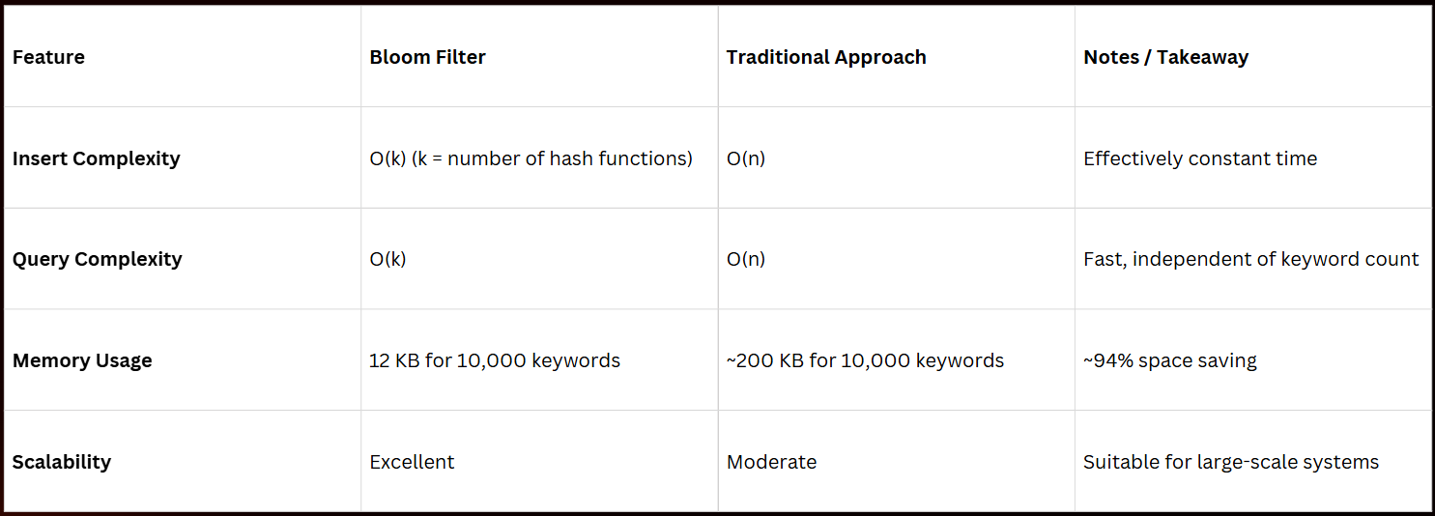
EMAIL SPAM DETECTION
COMPLEXITY ANALYSIS
(Bloom-filter )
06

Slide 8
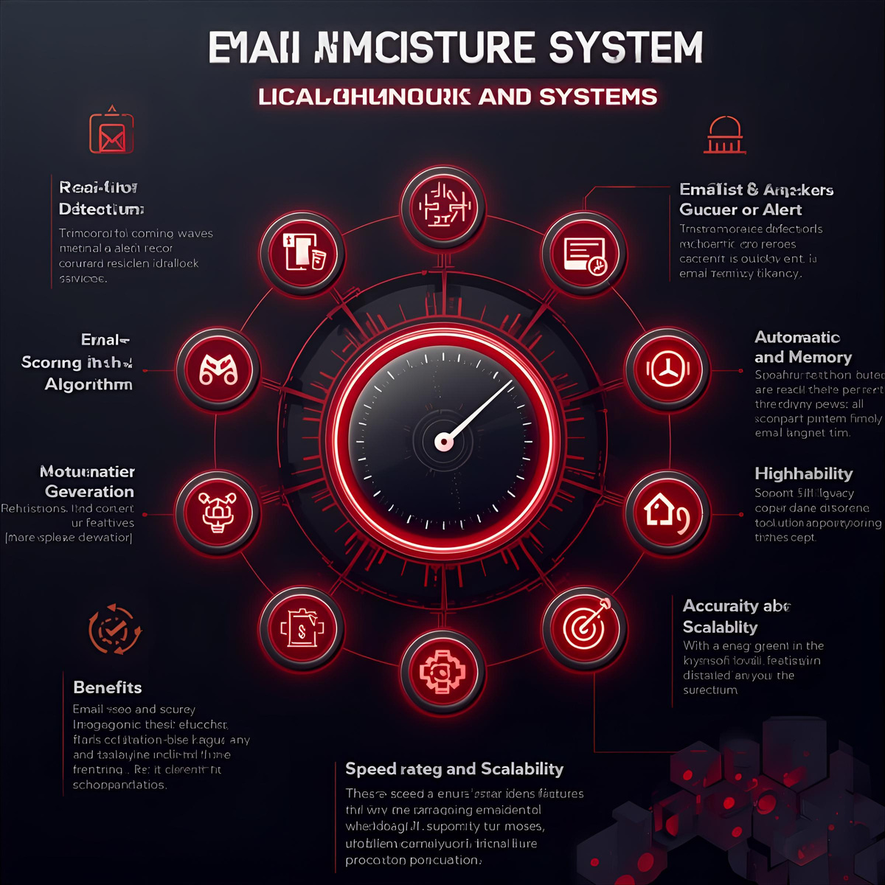
EMAIL SPAM DETECTION
KEY FEATURES & ADVANTAGES
Key Features
Real-Time Detection – Fast spam scanning using Bloom Filter (check_message()).
Bulk Keyword Loading – Supports large dictionaries (load_from_file()).
Phrase Matching & Scoring – Detects words/phrases and assigns spam scores.
Performance & Reporting – Includes benchmarking and detailed statistics.
Advantages
High-Speed – Processes 1000+ messages/sec with low latency.
Memory-Efficient – Bloom Filter saves significant storage space.
Accurate – Reduces false positives with optimized keyword checks.
07

Slide 9
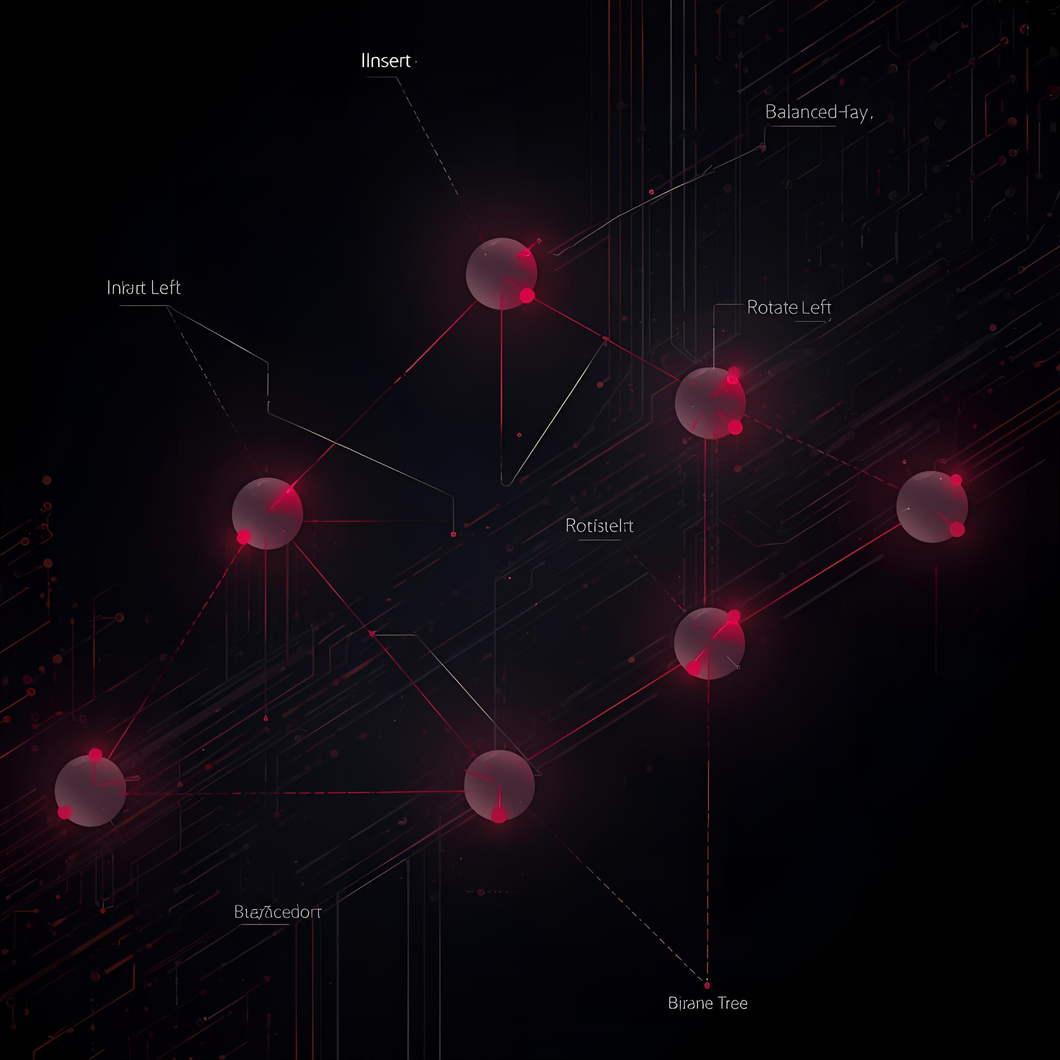
EMAIL SPAM DETECTION
RED-BLACK TREE CORE
Red Black Tree, which is the heart of our email spam filtering system.
The red-black tree is a self-balancing binary search tree, ensuring that data operations like insertion, searching, and updates happen efficiently.
Implemented an insert_domain method to manage and categorize domain reputations based on spam activity.
To maintain balance, we used color-fixing and rotation algorithms, including
_insert_fixup
_left_rotate
_right_rotate
These algorithms keep the tree balanced after every operation.
08

Slide 10
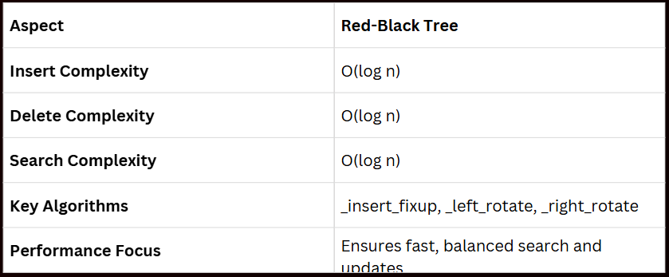
EMAIL SPAM DETECTION
COMPLEXITY ANALYSIS
(Red Black Tree)
Insertion Operation: The time complexity of inserting a new domain depends on the data structure used — typically O(log n) for balanced structures.
Search/Check Operation: Checking whether the domain already exists before insertion takes O(log n).
Overall Complexity: The average time complexity per insertion is O(log n), ensuring efficient performance for large datasets.
09

Slide 11
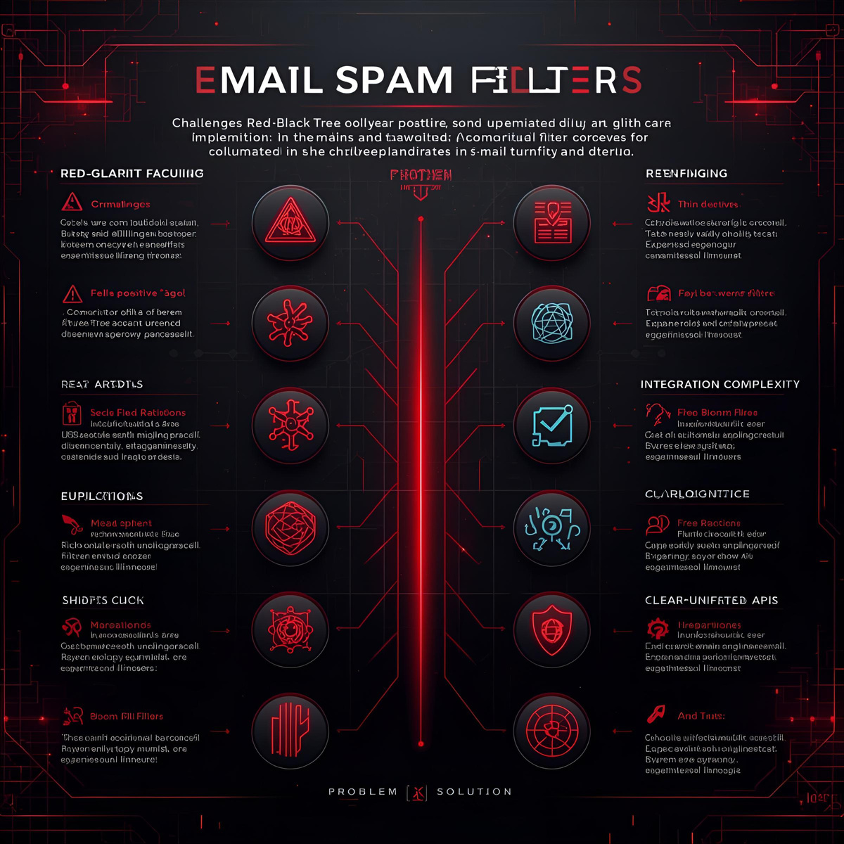
EMAIL SPAM DETECTION
CHALLENGES & SOLUTIONS
Adaptive Filtering: Integrate machine learning to learn from new spam patterns.
Scalability: Move to a distributed architecture to handle millions of emails daily.
Enhanced Features: Add IP address tracking, attachment analysis, and other advanced checks.
10

Slide 12

EMAIL SPAM DETECTION
This module serves as the administrative backend, fulfilling the rubric's requirement for a specific, non-display-related module.
DOMAIN ANALYTICS &
I implemented the logic to *report spam domains, which lowers their reputation, and to **whitelist trusted domains*, which boosts their score. A key feature is the generate_reputation_report function, which traverses the tree to provide comprehensive statistics. Finally, I added functionality to *export data*, such as generating a text-based blacklist or a full JSON report."
REPORTING
11

Slide 13
EMAIL SPAM DETECTION
SYSTEM INTEGRATION
We've created a working demo that showcases all our core features.
The system first *loads over 50 spam keywords* into the Bloom Filter and *populates the Red-Black Tree with 9 known domains, each with a predefined reputation score. We then process several test emails. As you can see from the sample output, our system analyzes the email from 'winner@spam-domain.net', flags multiple keywords, checks the domain's **blacklisted status, and correctly assigns a high spam score, marking it as **SPAM*."
12

Slide 14

EMAIL SPAM DETECTION
Our system provides a strong foundation that can be extended in several ways. The most promising next step would be to integrate machine learning to create an adaptive filter that learns from new spam.
We could also scale the system
to a distributed architecture
to handle millions of emails
per day, and add new features
like IP address tracking or
attachment analysis.
FUTURE ENHANCEMENTS
14

Slide 15
EMAIL SPAM DETECTION
CONCLUSION
we have successfully designed and implemented a high-performance email spam filter that demonstrates the practical power of advanced data structures. We achieved our goals of creating a system that is fast, memory-efficient, and accurate.
This project taught us that *Bloom Filters are exceptional* for space-efficient membership testing, while *Red-Black Trees provide the guaranteed O(log n) performance* essential for scalable, real-world applications. Our team successfully integrated four distinct modules into a seamless, production-ready system.
15

Slide 16

EMAIL SPAM DETECTION
DOCUMENTED MEETINGS
To meet the teamwork rubric requirements, we maintained a structured collaboration process. We held four key meetings, starting with topic selection and design, moving through module reviews and integration, and ending with final testing and presentation prep. All our progress, including meeting minutes and development history, is documented through Git commits and our team chat logs.
16

Slide 17
EMAIL SPAM DETECTION
THANK YOU
17

